Slide 1
Risk Financing Mechanisms for Climate Change Mitigation in the Agriculture Sector ALASA June 1, 2023
Diego Arias
Manager, Agriculture & Food
Latin America and Caribbean Region

Slide 2
Key messages
Reducing GHG emissions from agrifood systems is critical to address climate change in the short and long run.
Climate financing is falling short in the amount of resources needed, but important action is taking place to scale up financing.
The agrifood and land use sectors (AFOLU) attract relatively low levels of climate financing.
There are important experiences of innovative risk financing approaches to leverage climate financing for agriculture.
Opportunity from LAC governments to: (i) improve the enabling environment for risk financing for the agrifood sector; and (ii) re-orient existing public supports toward climate outcomes, leveraging climate financing and risk financing.
Notes:
Revise the priority pathways message (bring to the end and focus on methane)

Slide 3
What is the GHG emisión situation in LAC and in the Agrifood Sector?

Slide 4
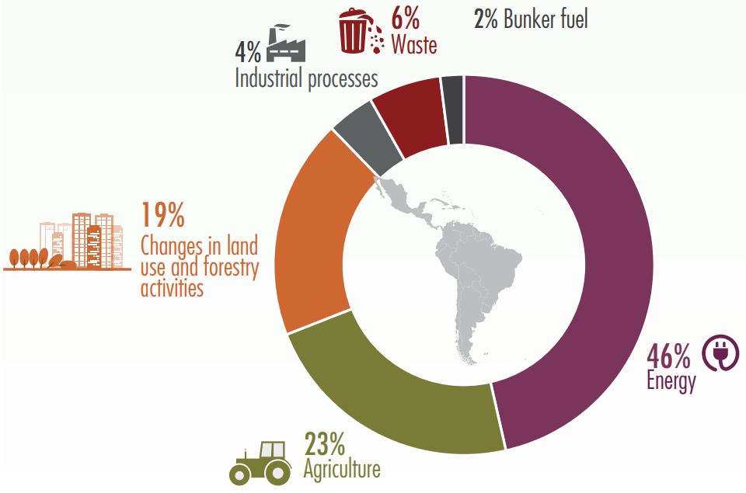
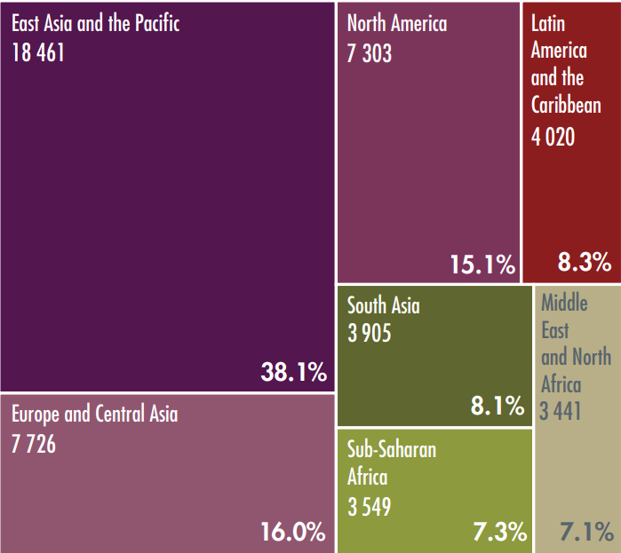
Although LAC is less than 10% of total global GHG emissions, AFOLU in LAC is 25% of Global AFOLU emissions and 42% of total LAC emissions.
LAC: GHG emissions (2014)
Global GHG emissions by Region (Megatons of CO2 equivalent (MtCO2 eq) and %)
Source: CEPAL, 2019
Notes:
[Message] Las emisiones de GEI de ALC representan solo el 8,3% de las emisiones globales. Sin embargo, dentro de ALC, el sector agrícola, sin contabilizar LULUCF, representa el 23% de las emisiones de GEI de la región. El sector puede ser parte de la solución para reducir las emisiones, al tiempo que gana productividad y genera mayores ingresos.
Fuente: CEPAL, 2019 https://www.cepal.org/sites/default/files/infographic/files/infographic_economics_of_climate_change.pdf

Slide 5
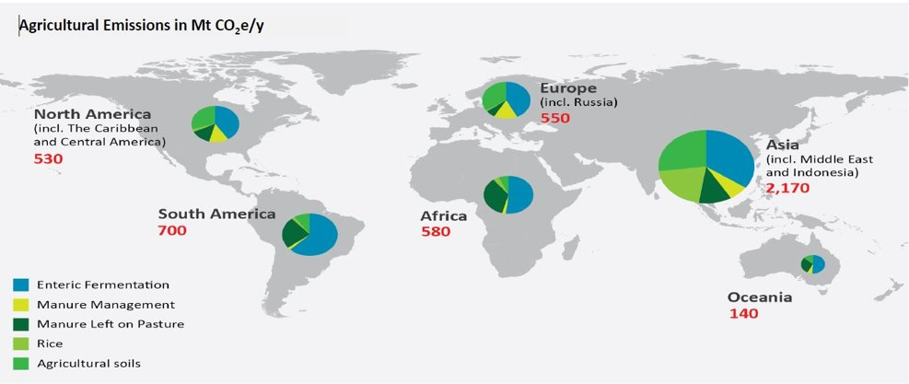
Why we focus on methane emissions from livestock in LAC?
Fuente: FAOSTAT data from 2010 (accessed 2013); area of pie charts scaled to regional emissions.; California Environmental Associates 2013, unpublished. Based on data from FAOSTAT 2010.; GLEDTALKS; World Bank​
Notes:
[Message]: Nearly 40 percent of total livestock emissions come from enteric fermentation but the greater part, almost 50 percent, is due to feed production, including: manure application and deposition (16 percent); eld work (13 percent); fertilizer application (8 percent); and land-use change for soybean, palm oil and pasture expansion (9 percent).

Slide 6
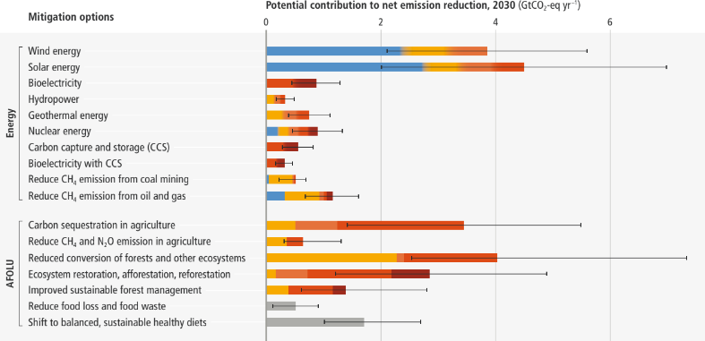
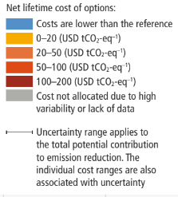
AFOLU mitigation measures have high initial costs but have a relatively larger potential for emisión reductions than in many other sectors
Fuente: PCC, 2022: Summary for Policymakers. In: Climate Change 2022

Slide 7
State of Climate Financing for the Agrifood Sector

Slide 8
Understanding Different Types of Climate Finance
INTERNATIONAL PUBLIC CLIMATE FINANCE
OTHER CLIMATE FINANCE
Finance deployed directly through the MDB and bilateral systems
Other funding sources that can be catalyzed by international public climate finance, such as:
DEDICATED CLIMATE FINANCE
___________________________________
Concessional Finance with Climate Focus
Example: grant funding from the Global Environment Facility to boost CSA technologies
DEVELOPMENT FINANCE, WITH CLIMATE CO-BENEFITS
___________________________________
MDB balance sheet investment with climate co-benefits
Example: World Bank loan for a climate-resilient agrifood innovation system
PRIVATE FINANCE
___________________________________
Commercial for-profit investment in climate assets
Example: Investment in precision agriculture technologies
GOVERNMENT BUDGETS
___________________________________
Domestic government spending supporting climate goals
Example: Switching from blanket subsidies to farmers, to subsidizing adoption of CSA technologies
CARBON MARKETS
___________________________________
Revenues from selling carbon emission offsets
Example: Avoided deforestation project sells emission reductions to US company with net-zero pledge
Notes:
What does Climate Finance mean?
At a time when everyone is throwing the term around – climate finance, green finance – it’s worth stepping back to look at the full range of what we’re talking about.
Just as one example, this slide differentiates between:
INTERNATIONAL PUBLIC CLIMATE FINANCE
Dedicated Climate Finance (example: weather forecasting, climate resilient seeds or crops)
Development Finance, with Co-Benefits (Joint Methodology for Climate Finance)
OTHER CLIMATE FINANCE
Private Finance or investors in search of business models with revenue streams
Government budgets, the mainstay of climate action, can be bolstered by a carbon tax and good fiscal policies and rules
Carbon markets – the other form of carbon pricing – whereby revenue is generated from selling carbon credits

Slide 9
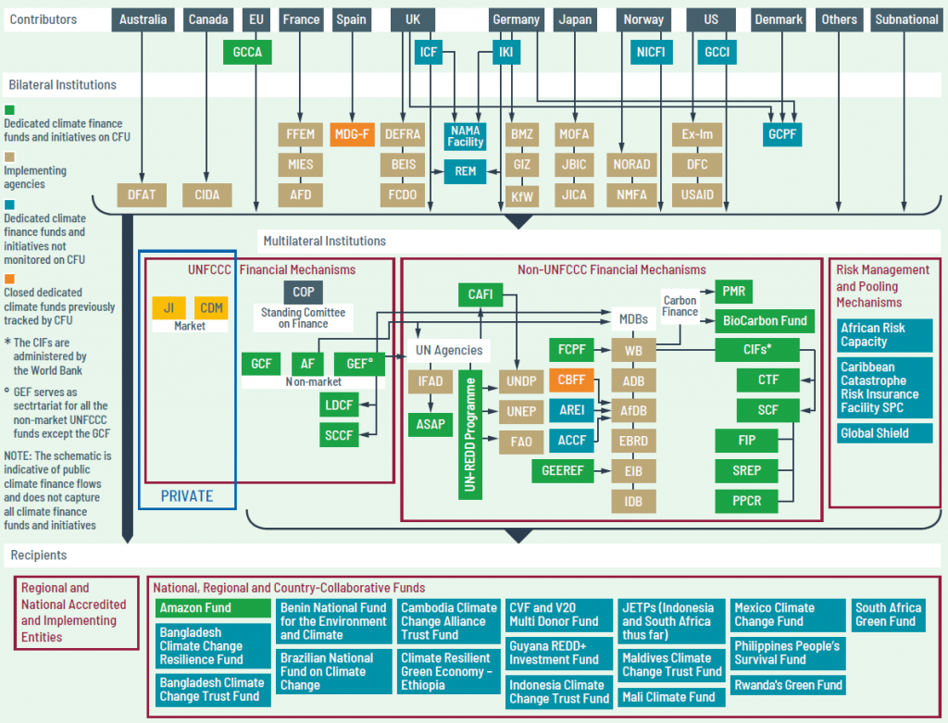
The Climate Financing Architecture is complex

Slide 10
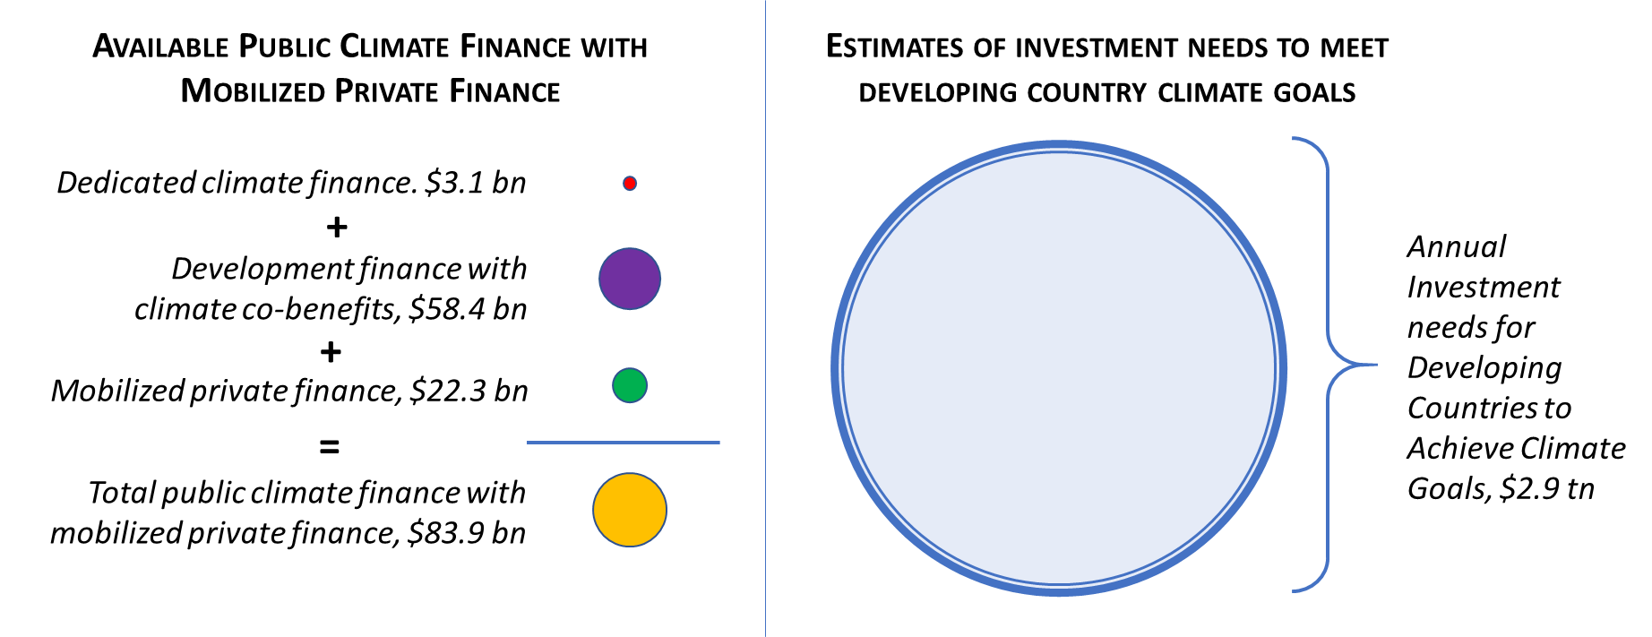
International public climate finance is limited
Current public + mobilized Climate Finance levels meet < 3% of investments needs
If all MDB operations were 100% climate finance, would still only meet less than 8% of needs
All MDB operations would need to be multiplied by nearly 12 to reach level of finance needed
Notes:
But this remains a drop in the bucket.
This specific data is a few years old but take this as an illustrative example of the scale of our financial flows – and where we need to go.
If developing countries need anywhere from 2.5 to 3 trillion annually to achieve their climate goals, look at where we are.
Current public + mobilized Climate Finance – the sum total of everything in the lefthand column - meets < 3% of investments needs
If we took all MDB finance and made it 100% devoted to climate – which would never happen – you would need to multiply that number by 12 to get enough financing to meet the annual climate investment needs of developing countries.

Slide 11
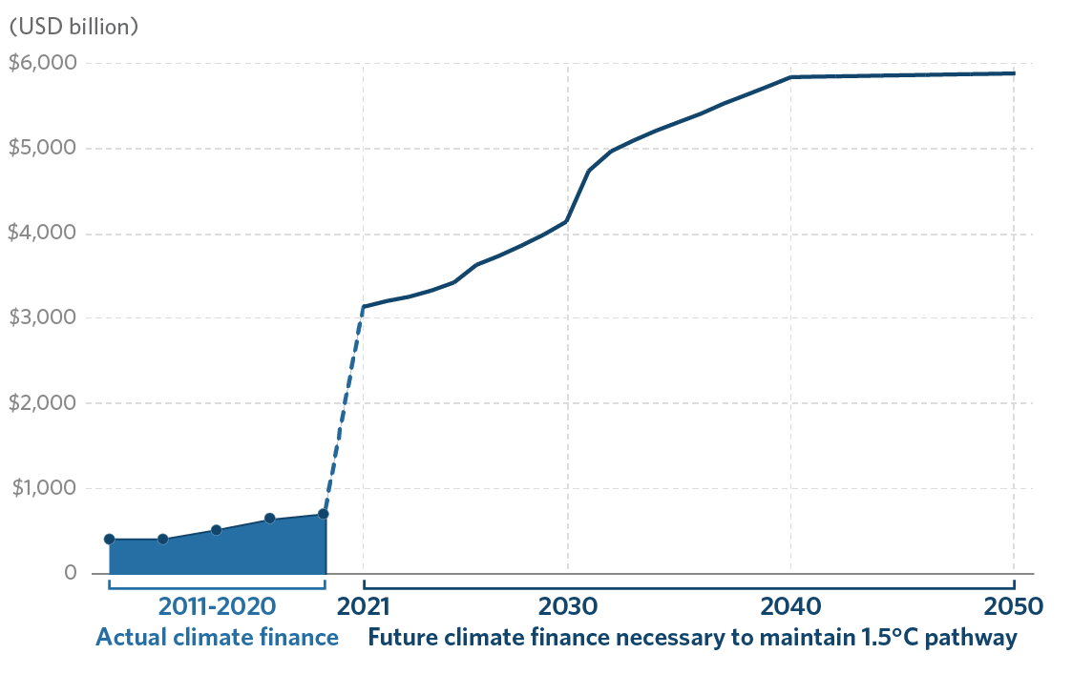
Global climate finance levels must rise
Notes:
There are major challenges in the world of climate finance, chief among them being that current climate finance levels are very, very low.
This data from CPI – the Climate Policy Institute – at the decadal scale shows where we are and where we need to go.
Globally, the world needs about $6 trillion annually in global climate finance. A great deal of that will have to be private.
For developing countries alone, estimates of climate investment needs vary, but the Bank has traditionally estimated between $2.5 to 3 trillion annually – or just under HALF of the total.
Of course, where we are now is much lower, about 500-700 billion per annum globally in the last few years – of which only a small fraction is going to development countries.

Slide 12
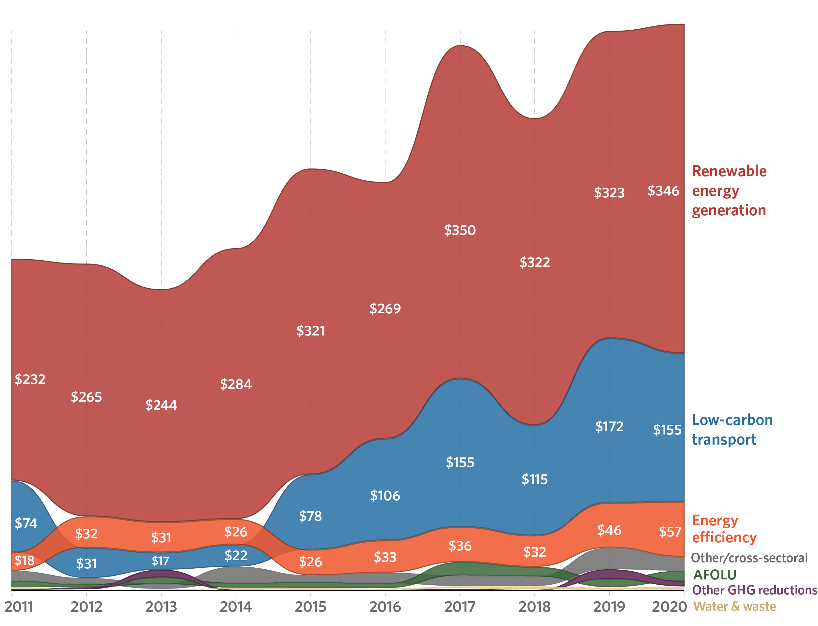
But must rise especially in the agrifood sector and AFOLU
AFOLU is 23% of global GHG emissions and half of methane emissions, but only receives 2% of Climate financing (IPC,2022a).
Fuente: CPI Global Landscape of Climate Finance, 2022

Slide 13
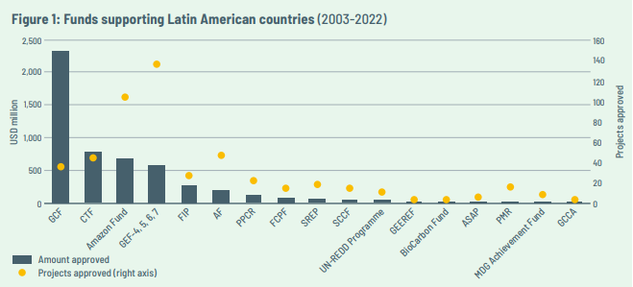
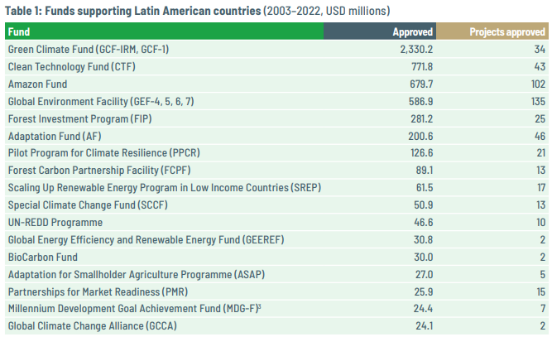
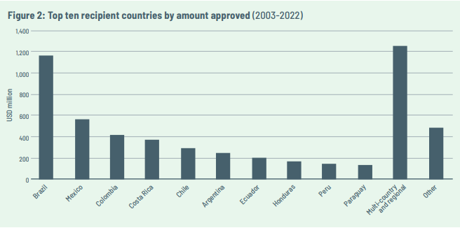
Total climate financing for LAC
Fuente: Climate Fund Update, ODI, February 2023

Slide 14
Main barriers for accessing Climate Financing for the agrifood sector
Information on available solutions.
Markets
Technical
High costs of MRV and studies.
Institutions
Limited guarantees and insurance for credit deals.
High transaction costs (small scale farmers and small scale of deals)
Difficulties in property rights (land titles) for collateral.
Insufficient market information (on clients and agroclimatic data).
Fuente: CPI Global Landscape of Climate Finance, 2022

Slide 15
How can the World Bank support LAC countries?

Slide 16
WBG is the leading provider of Climate Finance to Developing Countries
Total MDB climate finance to low- and middle-income countries, 2021
Notes:
Just to show a sense of scale.
Among MDBs, the WBG is by far the leading provider, globally, of climate finance to developing countries.
In 2021, the WBG provided over HALF of the total of $50 billion.

Slide 17
WBG Climate Finance has tripled in the last 6 years
31.7
26.6
20.5
21.4
$ billion
17.8
12.9
10.8
Notes:
And that number has gone up.
The WBG’s climate finance has tripled in the last 6 years from about $10 billion per annum to about $30 billion per annum.

Slide 18
We can Finance and facilitate you Access other sources of financing
Source | Objectives | Type of Financing | Amounts
Climate Investment Fund (CIF) (implementado a través de WB, ADB, AfDB, EBRD, and IDB) | finance programmatic interventions in selected developing countries, with the objective of improving understanding of how public finance is best deployed at scale to assist transformation of development trajectories. | Grants | Total pledge of US$ 10,6 mil millones
Partnership for Market Implementation (PMI) | establishment market-based mechanisms to respond to climate change | Multilateral - Grants and TA | Pledge US$131 million
Carbon Partnership Facility (CPF) | development of emission reduction programs / creates carbon assets | TA and grants through Carbon Fund and Carbon Asset Development Fund | $130 million under management
IDA/IBRD | operaciones de inversiones y políticas | Loans | US$26,2 Billion in Climate Finance in FY22
Green Climate Fund (GCF) | climate funds to accelerate green market creation, unlocking the financial flows needed for developing countries to transition to low-emission and climate-resilient development | Multilateral - Grants, debt, equity, guarantees and insurance | Cartera vigente US$11,4 mil millones Nueva: Ventana 2024-2027 (GCF-2)
Bio-carbon Fund | public-private partnership to mobilize and provide finance for sequestration or conservation of carbon in the land use sector | Multilateral | Pledge US$ 349 millions
Forest Investment Program (FIP) (implementado a través de WB, ADB, AfDB, EBRD, and IDB) | Projects to promote sustainable forest management | Grants and concessional loans | US$ 785 million
GEF Food Systems, Land Use and Restoration Impact Program (FOLUR) | Projects to transform the global food system by promoting sustainable, integrated landscapes and efficient commodity value chains | Multilateral - Grants | US$345 millones
Notes:
Some examples

Slide 19
¿What are the Risk Financing solutions?

Slide 20
Agricultural Risk Management and insurance
What is a broader context for agricultural risk management?
How insurance fits in?
Production risks
Weather related risks that impact agricultural production, livestock and fisheries
Climate risks (e.g. risks from significant changes in weather patterns)
Pest and diseases that impact agricultural production, livestock and fisheries
Market risks
Price risk of agricultural products, livestock and fisheries
Losses during storage, transportation and logistics
Market access risks such as change in demand, consumer preferences, loss of an important market, etc.
Policy and regulatory risks
Change of regulations and policies can disrupt agricultural markets

Slide 21
Agricultural risks and insurance
Production risks tend to be the most prevalent ones causing the biggest losses of income for agricultural producers
Insurance is one of the instruments for agricultural risk management
However, investments to reduce agricultural risks are needed in cases of severe and frequent catastrophic events, like for example, severe droughts and floods (e.g. investments in irrigation, flood control, etc.)
An agricultural risk management strategy requires a combination of instruments encouraging risk reduction and risk transfer

Slide 22
Financial instruments for Agri Risk Management
Risk adaptation and risk mitigation requires Longer Term investments to reduce risks and better cope with them. These can involve the following suit of financial instruments:
Long term debt
Blended finance (blending commercial funds with grants focusing on specific investments and perhaps targeted beneficiaries)
Guarantees to incentivize investments
Risk transfer
Agricultural insurance (commercial farming focused mostly)
Catastrophic compensation programs for disaster risks (targeting risks and beneficiaries…..good examples in LAC region)

Slide 23
Key messages on Agriculture Insurance
Insurance on its own is an incomplete solution for agricultural risks…even for weather or production risks. It addresses only part of the weather and production risks that require risk transfer;
Insurance has more impact (and bigger demand) if it is part of a broader strategy to reduce risks and part of a package of products and services that improve access to new technologies, credit and markets;
Insurance does not replace ex ante measures to reduce risks, but can be designed in ways to promote climate adaptation (promote investments in smart agriculture).

Slide 24
Agricultural insurance and disaster aid
Governments compensate farmers and rural people in cases of natural disasters
Usually this happens in the form of disaster assistance or payments, like in the form of conditional cash transfers when disasters strike
Sometimes such disaster assistance can reduce demand for agricultural insurance
The interaction of programs to provide disaster aid with efforts to promote agricultural insurance should be considered very carefully to ensure complementarity rather than substitution between disaster aid and agricultural insurance

Slide 25
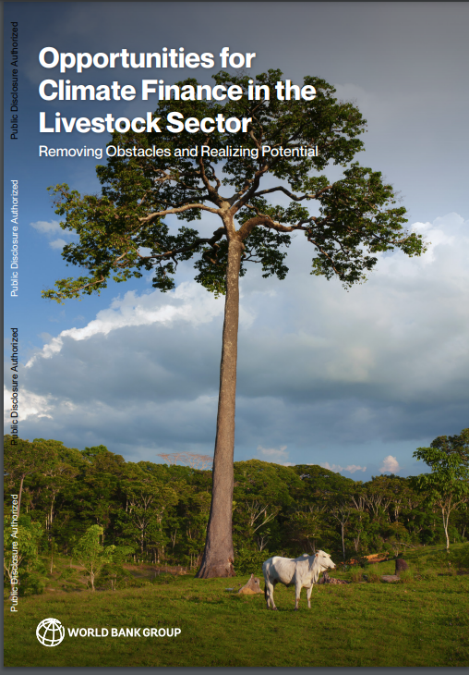
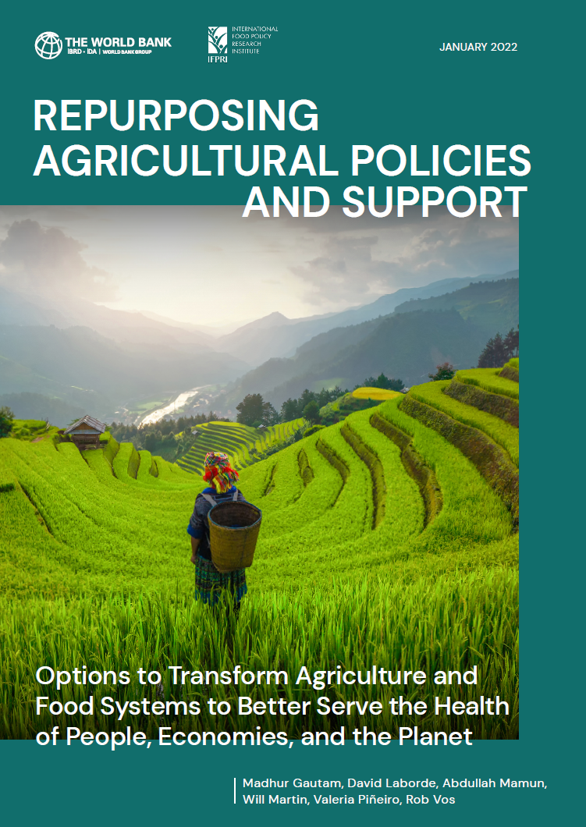
Recent World Bank publications
https://www.worldbank.org/en/topic/agriculture/publication/opportunities-for-climate-finance-in-the-livestock-sector-removing-obstacles-and-realizing-potential
https://openknowledge.worldbank.org/handle/10986/36875

Slide 26
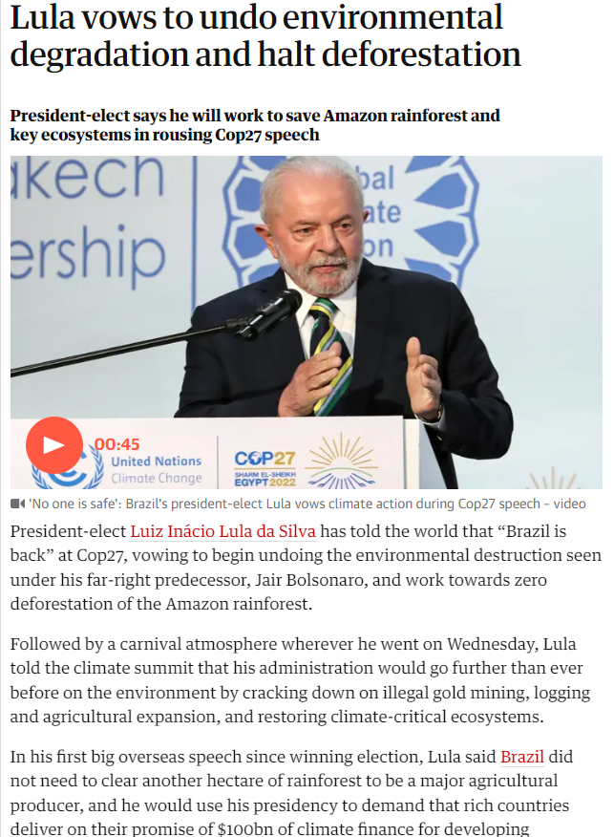
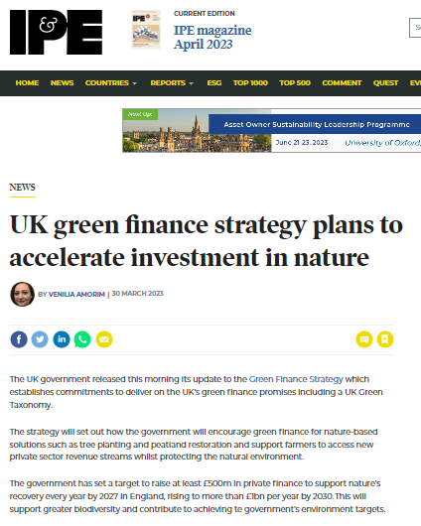
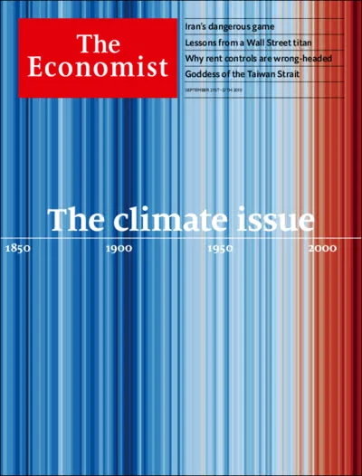
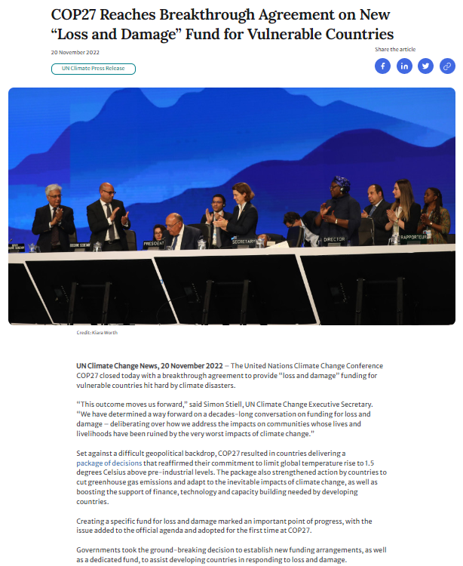
The time to bring Climate Finance to the agrifood sector is now!
Notes:
The conversation on climate finance is taking place at a critical time – and is all around us. You only need to open the newspaper to see that the climate finance agenda is entering a new phase.
There is increasing momentum and awareness, and more and more partnerships being established between governments, investors, international organizations, philanthropies, and think tanks.
COP27 closed last year with a breakthrough agreement to provide “loss and damage” funding for vulnerable countries hit hard by climate disasters.
President Lula in Brazil campaigned on promises to help the world fight climate change by protecting the Amazon rainforest, and immediately reinstated the Amazon Fund, a $1 billion fund to protect of the world’s largest rainforest, after a three-year period of inactivity.
At end of March, the UK government released its update to the Green Finance Strategy to accelerate investments in nature. The strategy sets out how the government will encourage green finance for nature-based solutions such as forest and peatland restoration and to support farmers to access new private sector revenue streams whilst protecting the natural environment.

Slide 27
Gracias
darias@worldbank.org

Slide 28
Annex

Slide 29
¿Cuáles ejemplos de nuevos tipos de financiamiento climático en el sector agropecuario?

Slide 30
En ALC, varias fuentes y mecanismos de financiamiento para la mitigación están en practica, pero aún no están a la escala para generar la reducción de emisiones de GEI requerida.
Pais | Program | Fuente de financiamiento | Instrumiento | Monto
Brazil | Plan Sectorial de Agricultura Baja en Carbono (Plan ABC) | Gobierno | línea de crédito subsidiada para que los agricultores conviertan las prácticas tradicionales de gestión agrícola en prácticas bajas en carbono | US$1,2 mil millones/ano
Brazil | Proyecto ABC Cerrado | FIP Donación | Asistencia técnica y capacitación en prácticas de restauración de pastos | US$10 millones (para 6 anos)
Uruguay | Sistema de trazabilidad bovina | Gobierno | Inversiones en el sistema de trazabilidad bovina impulsó la apertura de 120 mercados a la producción uruguaya. | US$ 12,5 millones/ ano
Colombia | Proyecto de Integración de la Ganadería Sostenible | GEF, BEIS Donación | Inversiones para convertir los sistemas de pastoreo convencionales en modelos sostenibles como los sistemas silvopastoriles | US$56 millones
Costa Rica | Programa de Pagos por Servicios Ambientales (PES) | Gobierno (impuesto a los combustibles y el cargo por agua), Certificados de Conservación de la Biodiversidad, créditos de carbono y alianzas estratégicas con el sector público y privado. | reconocimiento financiero por parte del Estado, a tráves del Fonafifo, a los (las) propietarios(as) y poseedores(as) de bosque y plantaciones forestales por los servicios ambientales | US$ 524 million
Notes:
[Message] En ALC, varias iniciativas están en marcha, pero aún no están a la escala para generar la reducción de emisiones de GEI requerida.

Slide 31
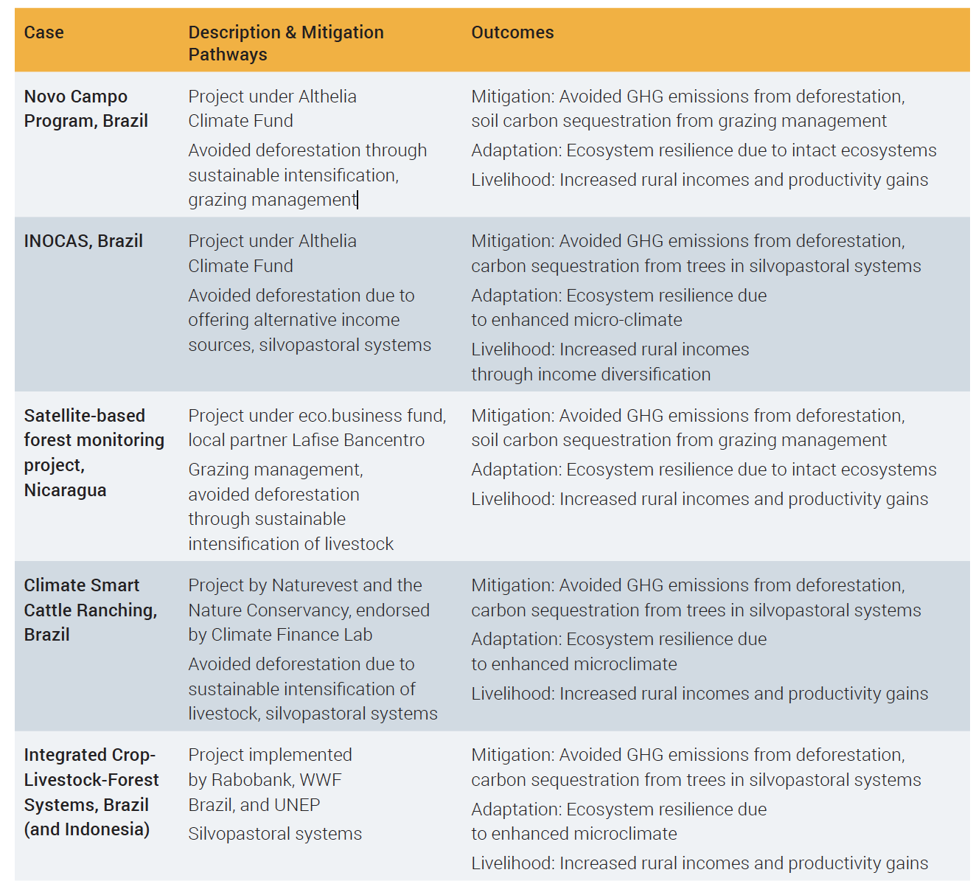
Financiamiento climático del sector privado para la intensificación sostenible de la ganadería en ALC
Notes:
[message] El sector privado jugará un papel clave en la implementación y consolidación de un modelo de negocios socioambiental que favorezca la trazabilidad ambiental e incorpore los esfuerzos sostenibles que realizan los agricultores en sus sistemas de producción, como la aplicación de estándares que les permitan cumplir con las buenas prácticas y los protocolos de mercado.

Slide 32
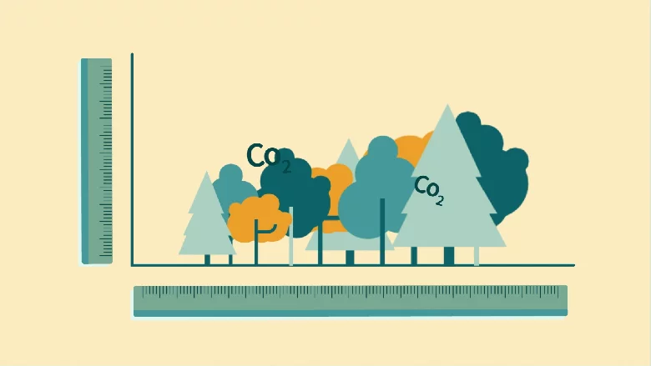
Invertir en monitoreo, informes y verificación de GEI (MRV)
Los sistemas robustos de MRV pueden generar resultados verificables a partir de las inversiones en mitigación, vinculándose a las NDC de los países y abriendo la puerta a una mayor financiación climática.
MRV a nivel de proyecto: el proyecto apoya la recopilación de datos y el desarrollo de capacidades para cuantificar las contribuciones del proyecto a la adaptación y la mitigación.
MRV a nivel nacional: el proyecto apoya el desarrollo de un MRV nacional para el ganado y las emisiones para ser utilizado por muchos proyectos y programas en todo el país.
Contabilidad nacional de emisiones: el proyecto convoca a diversas partes interesadas para facilitar el flujo de información desde las bases de datos a nivel sectorial hasta las bases de datos a nivel nacional.

Slide 33
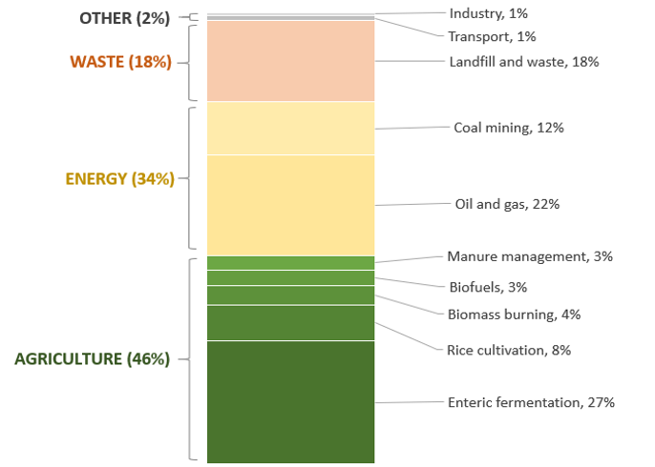
¿Cuáles son los puntos de entrada para que ALC reduzca las emisiones de GEI en la agricultura?
Global Anthropogenic Methane Emissions, by source 100% = 352 Mt CH4 in 2019
Cerrar de manera sostenible las brechas de rendimiento;
Reorientar los subsidios agrícolas;
Centrarse en las reducciones de metano en la agricultura
Source: CCAC/UNEP (2020). Global Methane Assessment
Notes:
[message] ¿Cuáles son los puntos de entrada para ALC? (a) cerrar las brechas de rendimiento de manera sostenible, (b) reorientar los subsidios agrícolas, (c) centrarse en las reducciones de metano agrícola.

Slide 34
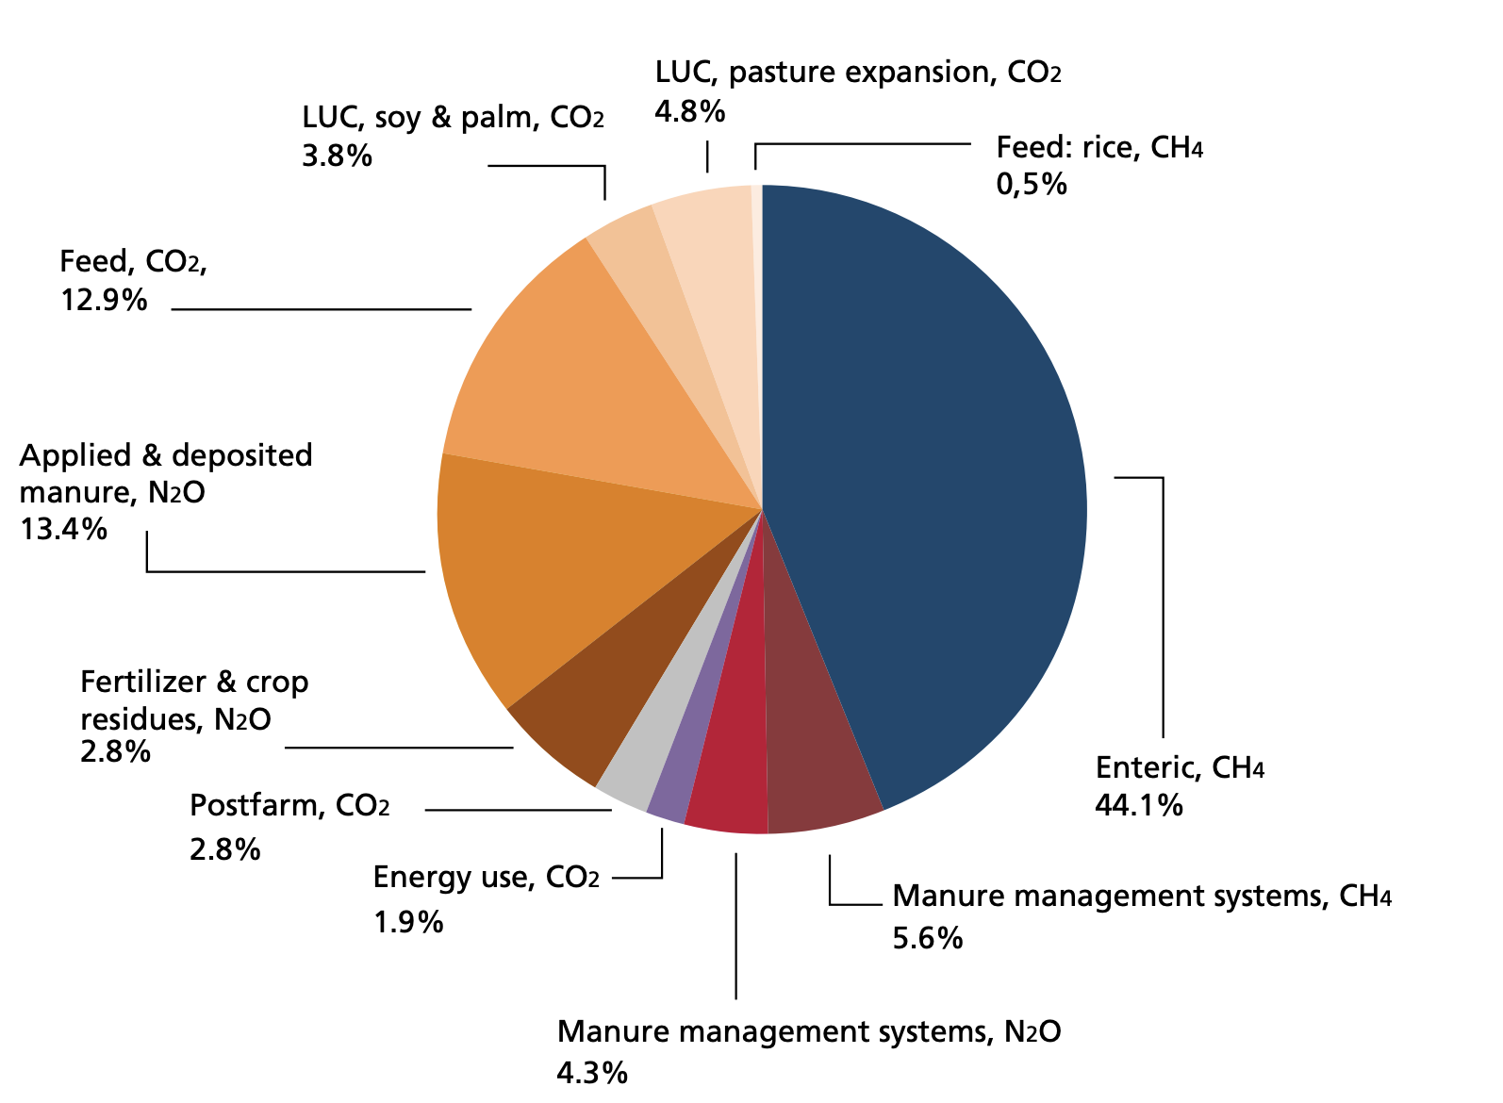
While the livestock sector and its value chains are responsible for about a sixth of GHG emissions, it can be part of the solution by reducing emissions and also putting carbon back into the soil
Livestock supply chains contribute ∼14.5% of all human-caused greenhouse gas emissions and account for as much as one-third of total emissions in Latin America.
Nearly 45%t of total livestock emissions come from enteric fermentation but the greater part, almost 50%, is due to feed production.
Source: FAO, 2017- GLEAM database, 2010.
Notes:
(slide 7) investing in the livestock sector makes sense since:
Livestock emissions from manure and gastroenteric releases account for roughly 32% of human-caused methane emissions. Population growth, economic development and urban migration have stimulated unprecedented demand for animal protein and with the global population approaching 10 billion, this hunger is expected to increase by up to 70% by 2050. Moreover, As part of the carbon cycle, livestock are both a sink and a source of energy.
Beef and cow milk are the two commodities with the highest total emissions, accounting for 3.0 and 1.6 gigatonnes CO2eq, respectively

Slide 35
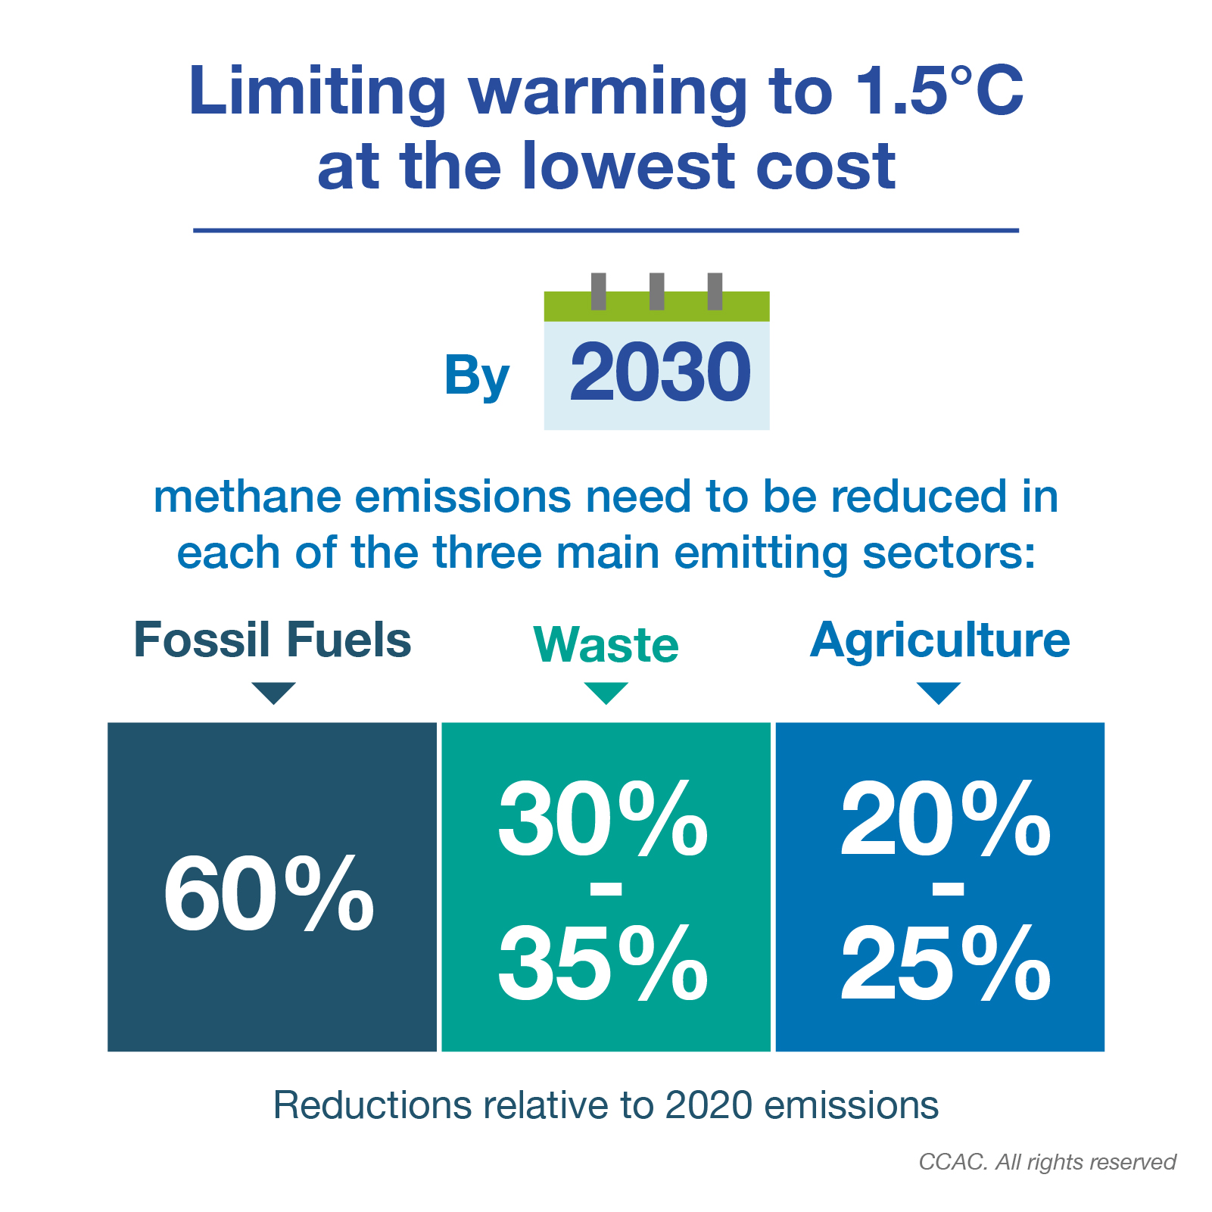
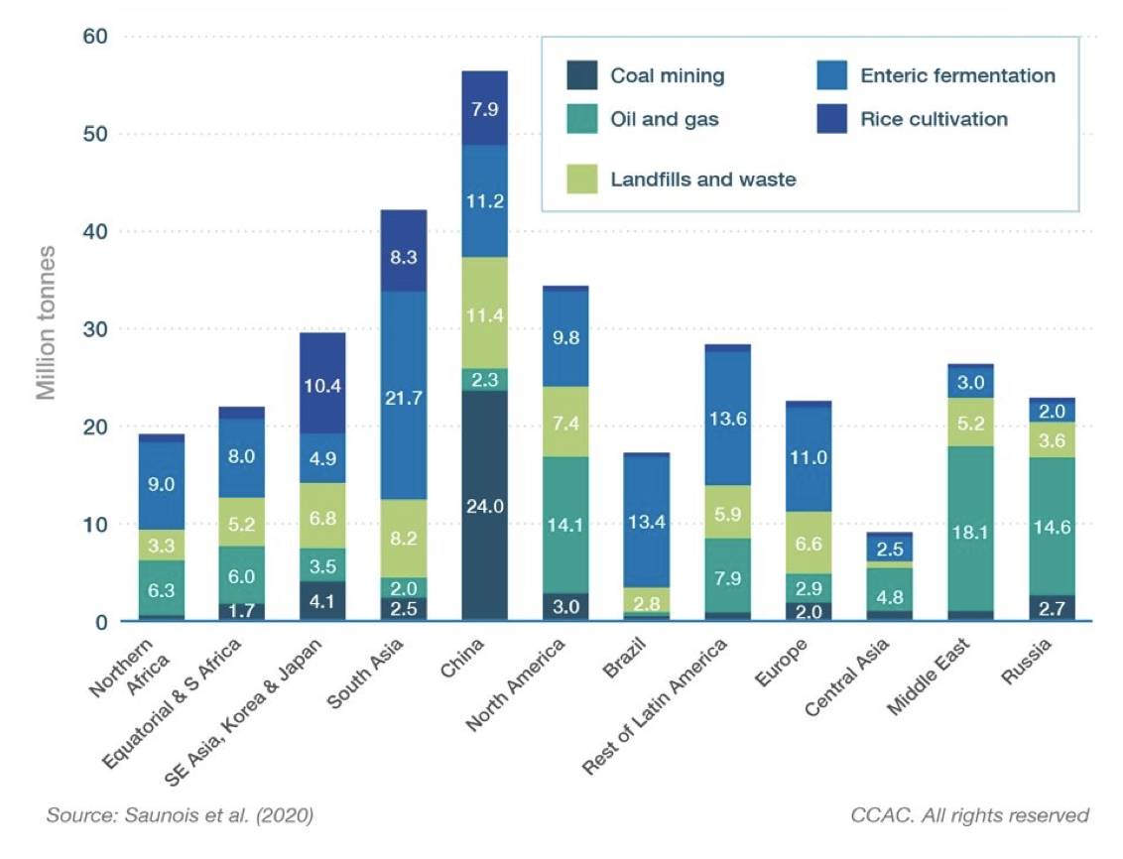
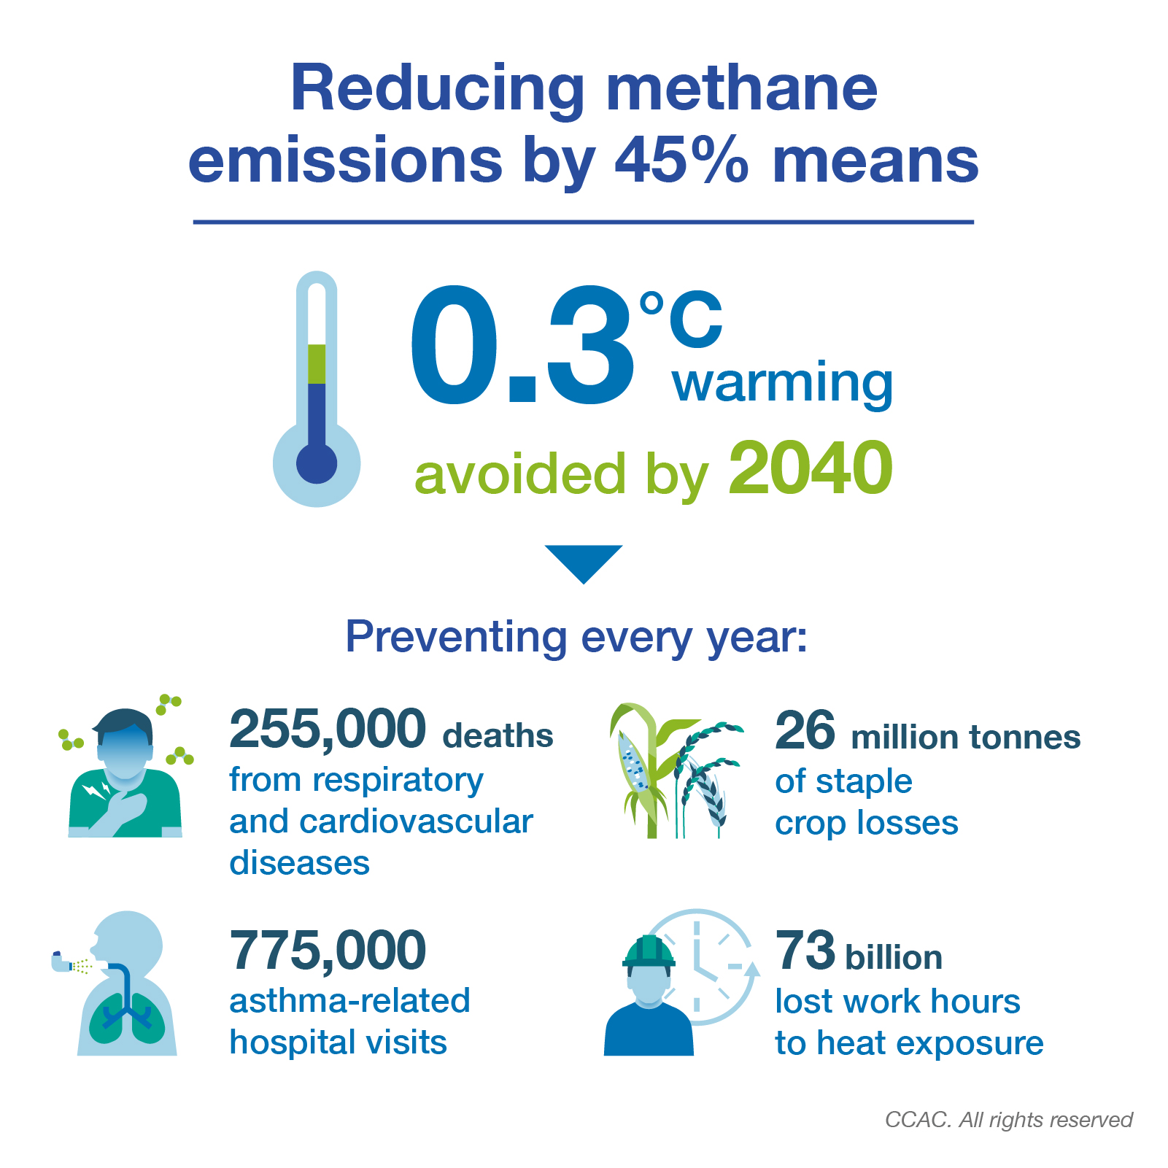
Estimated annual methane emissions by region and sector
Source: CCAC/UNEP (2020). Global Methane Assessment
Notes:
Main messages:
As part of the carbon cycle, livestock are both a sink and a source of energy.
While fossil fuel energy is required to produce feed and is also needed for milking and processing animal products, animal manure can be recycled – into biogas, through anaerobic digestion for example – and can thus provide an alternative to fossil fuels or fuelwood in livestock operations both large and small.
Nearly 40 percent of total livestock emissions come from enteric fermentation but the greater part, almost 50 percent, is due to feed production, including: manure application and deposition (16 percent); eld work (13 percent); fertilizer application (8 percent); and land-use change for soybean, palm oil and pasture expansion (9 percent).

Slide 36
The “what”: Scaling up known, validated approaches
Example: “readiness” of livestock sector mitigation interventions
Notes:
From a technical perspective: what changes in practice do we want the investment to incentivize?
Here we rely on a large inventory of validated, livestock sector mitigation technologies and practices.
These range from (see x axis) newer practices in “discovery” to known, validated “best practices.”
An FAO study from 2013 suggests there is a 30% mitigation potential associated with the bulk of producers (globally) adopting such “best practices” already existing within their production systems.

Slide 37
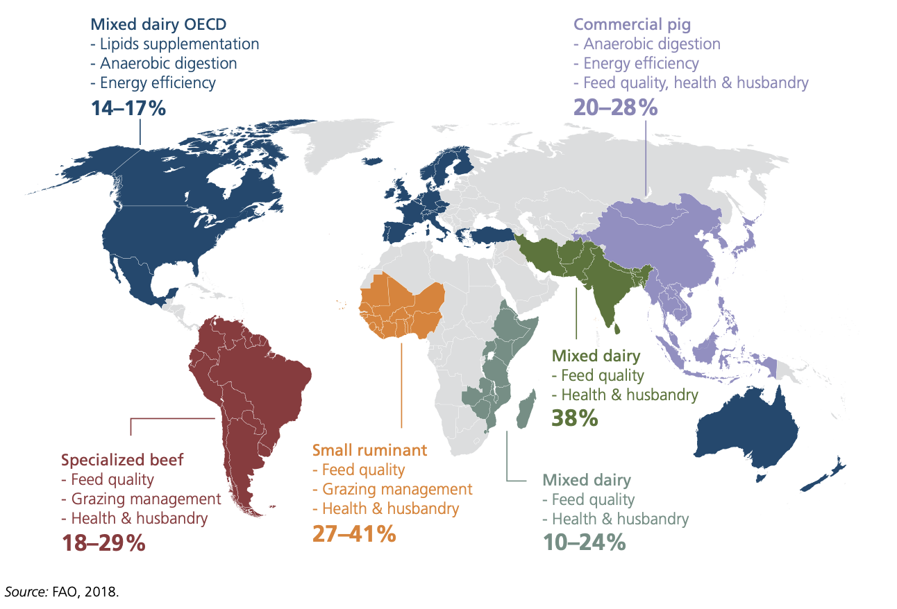
The “what”: Scaling up known, validated approaches
Efficient practices key to reducing emissions greenhouse gas emissions in the livestock sector can be reduced by 14-41% through adoption of feasible improvements in: feed quality | animal health and husbandry manure management | energy use efficiency
Soil carbon sequestration in pasture and grasslands is an additional practice with promising mitigation potential.
Adjustments in grazing pressure can sequester 148.4 Tg CO2 per year in grazing lands worldwide.
64% of the C sequestration potential is found in Central and South America (42.7 Tg CO2).
Source: FAO, 2018 (World Livestock: Transforming the livestock sector through the Sustainable Development Goals).
Notes:
Main messages: This gives an idea of the mitigation potential of such best practices.
Efficiency is key to reducing emissions and building resilience.
Approaches that improve cattle productivity while also enhancing carbon sequestration can contribute to the multiple goals of improving ranchers’ livelihoods, mitigating climate change,and reducing pressure on forests. Modifying the behavior of livestock producersis critical for reaching these multiple goals.
A number of technical mitigation and adaptation options are available to improve natural resource-use efciency. However, measures that go beyond the farm gate are also required, including institutional changes, disaster risk management, and social safety nets.
64% of the C sequestration potential is found in Central and South America (42.7 Tg CO2), East and SE Asia (20 Tg CO2) and sub-Saharan Africa (33 Tg CO2).

Slide 38
Situación actual de los apoyos al sector agrícola (políticas y programas) que desincentivan e incentivan la mitigación de GHG
The “how”: Re-orienting agriculture supports
Source: OECD and Agrimonitor BID
Notes:
[Message] En ALC hay espacio para reorientar las políticas agrícolas y los recursos financieros para aumentar el financiamiento y el apoyo climático mediante el cambio de algunos subsidios a la innovación y el financiamiento verde. Los gobiernos de ALC asignan montos significativos para el precio y el apoyo al productor.

Slide 39
WBG Climate Finance | $31.7 billion in fiscal year 2022
The World Bank Group continues to be the largest multilateral financier of climate action in developing countries.
Financing for climate action in FY22 exceeded the target set in the Group’s Climate Change Action Plan for 2021-2025 to deploy an average of 35% of the institution’s financing in support of climate action: it reached 36% of total Bank Group financing.
IBRD and IDA together delivered $26.2 billion in FY22 in climate finance. Building resilience to climate shocks is a priority. Nearly half of the Bank’s finance—$12.9 billion—supported investments in adaptation and resilience.
IFC, the private sector arm of the World Bank Group, delivered an unprecedented $4.4 billion in climate finance and mobilized an additional $3.3 billion from other sources.
MIGA, the World Bank Group’s political risk insurance and credit enhancement arm, delivered $1.1 billion in climate finance in FY22.
The Bank’s first Country Climate and Development Reports (CCDRs) are examples of our ongoing effort to help countries integrate climate and development objectives and prioritize the most impactful actions that can reduce greenhouse gas emissions and boost adaptation.

Slide 40
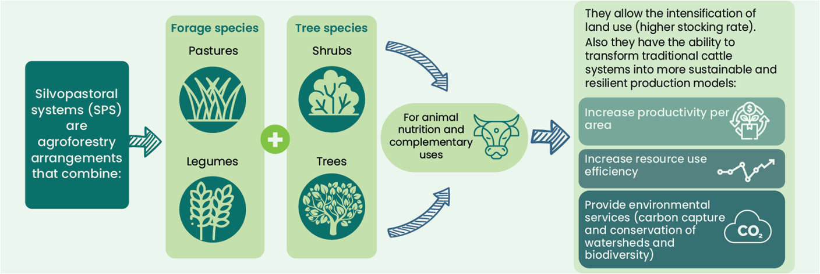
Ejemplos de proyectos de LAC
En Colombia, el Proyecto de Integración de la Ganadería Sostenible de US$56 millones ha convertido los sistemas de pastoreo convencionales en modelos sostenibles como los sistemas silvopastoriles, lo cual ha permitido la intensificar el uso del suelo (cargas animales 32,6 por ciento más altas); mejorar la productividad por área (17% por ciento más leche por hectárea intervenida) y secuestrar cantidades significativas de carbono (aprox. 1,5 millones de toneladas de CO2eq).
El proyecto ha apalancado/creado US$3,6 por cada US$1 proporcionado por las agencias de financiamiento (GEF, BEIS) y los socios del proyecto. Adicionalmente, ha creado un valor económico considerable, con rendimientos del 24,5 al 30,1 por ciento y un VPN por hectárea de US$ 1650 a US$ 1935, lo que indica que el proyecto es una inversión eficiente que crea simultáneamente valor monetario y social.
GEF: Global Environment Facility, BEIS: Business, Energy and Industry Strategy
Notes:
[message] Evidencias concretas de sinergias entre las intervenciones de mitigación y otros objetivos, ex: productividad, adaptación - Reducción de la intensidad de las emisiones a través del aumento de la eficiencia y la productividad

Slide 41
Ejemplos de proyectos de LAC
En Brasil, el proyecto FIP ABC Cerrado (US$ 10 millones) apoyó intervenciones para ampliar las prácticas de restauración de pastos, demostrando que US$ 1 invertido por el programa en capacitación y asistencia técnica de prácticas de bajo carbono alentó la inversión de US$8 por parte de los ganaderos y aumentó las ganancias en US$ 1,16-1,54 y redujo las emisiones de carbono en el equivalente de US$ 0,29 -0,38.
Notes:
[message] Evidencias concretas de sinergias entre las intervenciones de mitigación y otros objetivos, ex: productividad, adaptación - Reducción de la intensidad de las emisiones a través del aumento de la eficiencia y la productividad

Slide 42
En ALC, varias fuentes y mecanismos de financiamiento para la mitigación están en practica, pero aún no están a la escala para generar la reducción de emisiones de GEI requerida.
ALC puede ser el centro de innovación global para la agricultura climáticamente inteligente, mostrando el camino hacia la transición del sistema alimentario sostenible:
Brasil: Plan Sectorial de Agricultura Baja en Carbono (PLAN ABC), línea de crédito subsidiada para que los agricultores conviertan las prácticas tradicionales de gestión agrícola en prácticas bajas en carbono
Uruguay: Inversiones en el sistema de trazabilidad bovina impulsó la apertura de 120 mercados a la producción uruguaya. Uruguay invierte al año 12,5 millones de dólares en el sistema de trazabilidad del rodeo vacuno (;
Costa Rica es pionera en el Programa de Pagos por Servicios Ambientales (PES) agroforestal El mecanismo financiero financia a través del impuesto a los combustibles y el cargo por agua de Costa Rica, así como iniciativas propias, como Certificados de Conservación de la Biodiversidad, créditos de carbono y alianzas estratégicas con el sector público y privado.
Notes:
[Message] En ALC, varias iniciativas están en marcha, pero aún no están a la escala para generar la reducción de emisiones de GEI requerida.

Slide 43
Centrarse en reducir las emisiones de metano agrícola
El CH4 es uno de los principales GEI emitidos por los sistemas agrícolas en ALC.
En una escala de tiempo de 20 años, el metano es 86 veces más potente que el dióxido de carbono como gas de efecto invernadero.
Los enfoques de reducción de metano en los sistemas agrícolas son conocidos y validados.
Notes:
From a financing perspective: what instruments can we use to incentivize practice change?
Innovations in low-emission livestock sector financing is growing.
Here I’m showing a report that came out last year that identifies 6 major “opportunities” for climate finance in the livestock sector.
The first one for example “conditional credit lines”: this means a project develops a credit line targeted at producers that is conditional on adopting practices considered to be “low-emissions” or “climate-smart” in other ways: e.g. land management, manure management.
This types of work builds capacity on the part of the producer to adopt low-emissions practices, but also builds confidence and capacity on the part of the local financial sector to lend to producers under such conditions (which historically is considered risky).

